Slide 1
Unit 5-2
Midsegments of a Triangle
PLANE Geometry

Slide 2
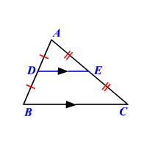
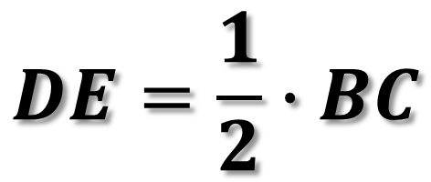
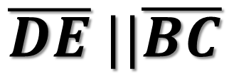

Triangle Midsegment Theorem
A Midsegment of a Triangle is a Segment with Endpoints that are the Midpoints of Two Sides of a Triangle.
Parallel to the Third Side
Half as Long as the Third Side
$$\overline{DE} ||\overline{BC}$$
$$DE=\frac{1}{2}∙BC$$
$$BC=2∙DE$$

Slide 3

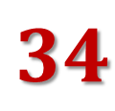
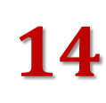






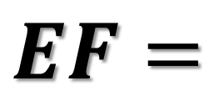



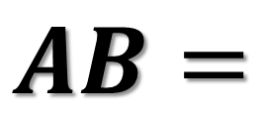
Example 1:
$$C$$
$$C$$
$$F$$
$$F$$
$$E$$
$$E$$
$$14$$
$$A$$
$$B$$
$$A$$
$$B$$
$$34$$
$$AB=$$
$$EF=$$

Slide 4
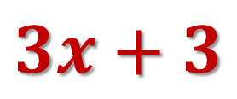
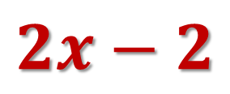






Example 2:
Find $x.$
$$C$$
$$F$$
$$E$$
$$2x−2$$
$$A$$
$$B$$
$$3x+3$$

Slide 5
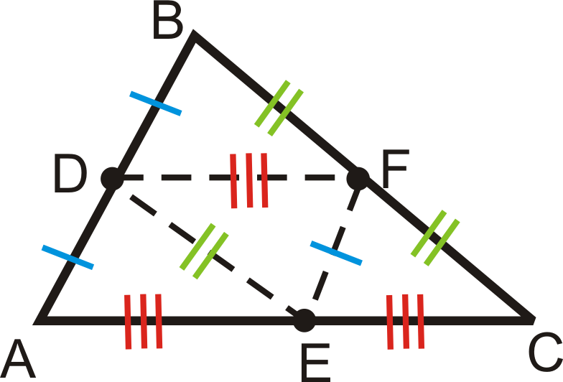
D, F, and E are all MIDPOINTS of Their Sides

Slide 6




Example 3:
Identify the Side Parallel to the Given Side.
$$C$$
$$\overline{CA}||$$
$$F$$
$$E$$
$$\overline{EF}||$$
$$A$$
$$B$$
$$D$$
$$\overline{BC}||$$

Slide 7

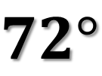





Example 4:
Find $m∠AMN$ and $m∠ANM.$
$$A$$
$$N$$
$$M$$
$$72°$$
$$C$$
$$B$$

Slide 8

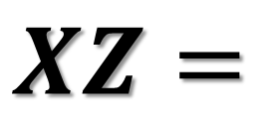



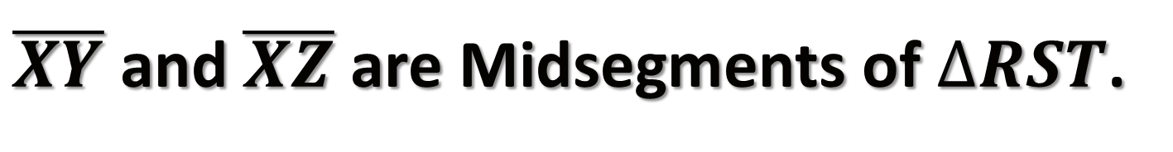






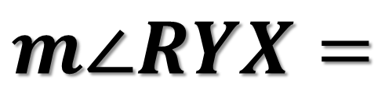
Example 5:
$\overline{XY}$ and $\overline{XZ}$ are Midsegments of $∆RST$.
$$S$$
$$ST=$$
$$X$$
$$Z$$
$$XZ=$$
$$124°$$
$$7$$
$$m∠RYX=$$
$$R$$
$$T$$
$$Y$$
$$13$$

